Slide 1
Some Linux Commands

Slide 2
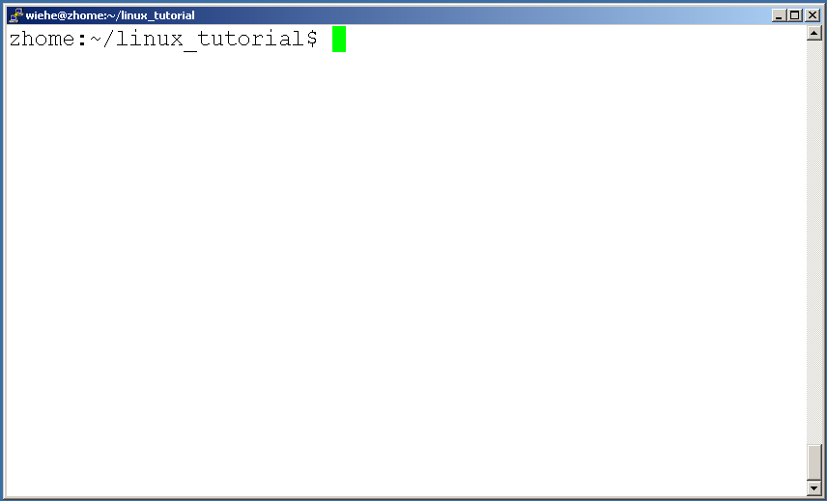
Connecting to a Unix/Linux system
Open up a terminal:

Slide 3
Connecting to a Unix/Linux system
Open up a terminal:
The “prompt”
The current directory (“path”)
The host

Slide 4
What exactly is a “shell”?
After logging in, Linux/Unix starts another program called the shell
The shell interprets commands the user types and manages their execution
    The shell communicates with the internal part of the operating system called the kernel
    The most popular shells are: tcsh, csh, korn, and bash
    The differences are most times subtle
    For this tutorial, we are using bash
Shell commands are CASE SENSITIVE!

Slide 5
Help!
Whenever you need help with a command type “man” and the command name

Slide 6
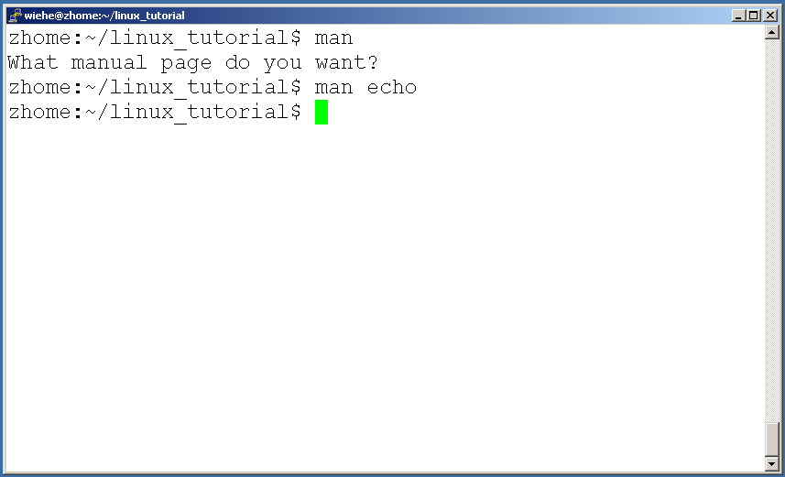
Help!

Slide 7
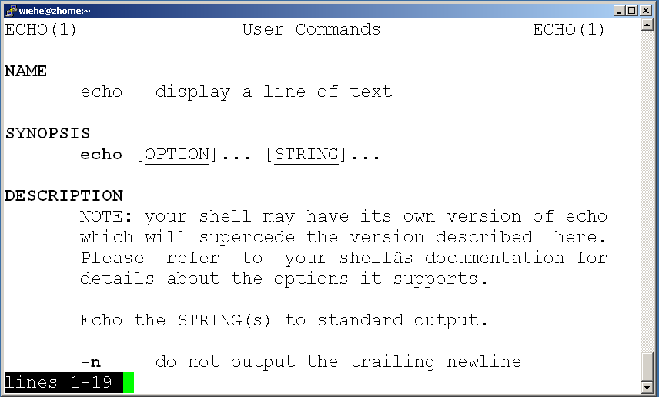
Help!

Slide 8
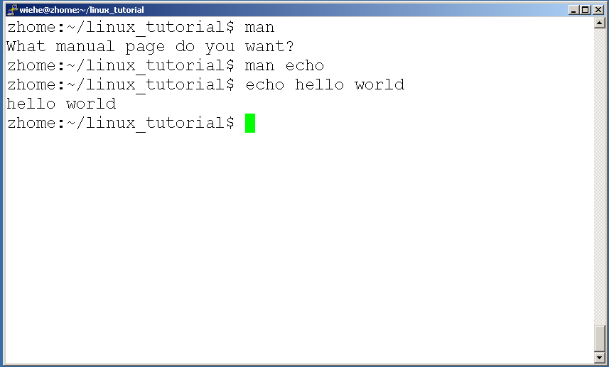
Help!

Slide 9
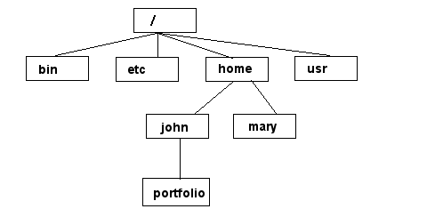
Unix/Linux File System
NOTE: Unix file names
are CASE SENSITIVE!
/home/mary/
/home/john/portfolio/
The Path

Slide 10
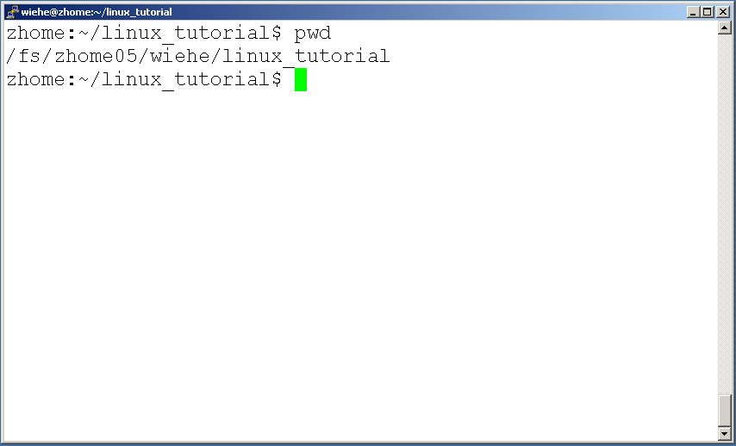
Command: pwd
To find your current path use “pwd”

Slide 11
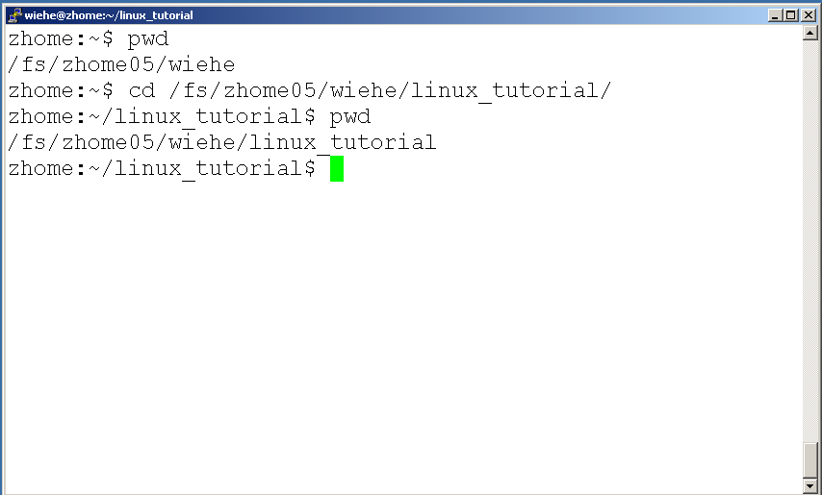
Command: cd
To change to a specific directory use “cd”

Slide 12
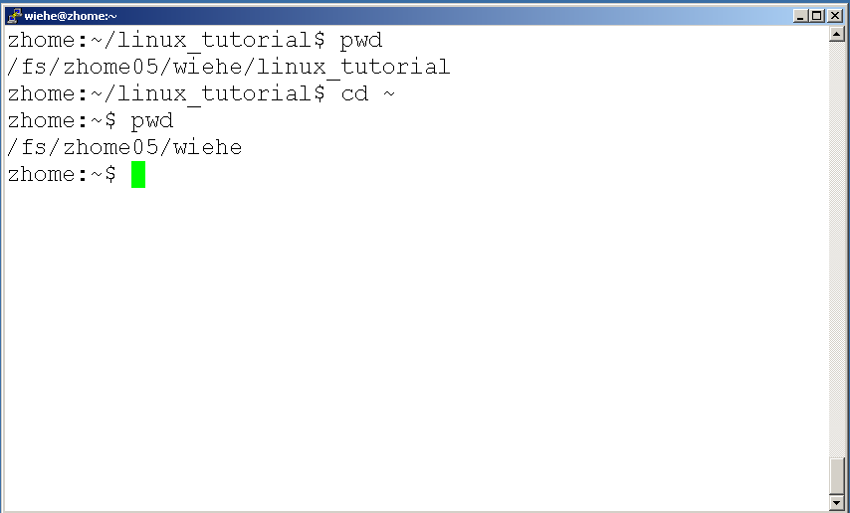
Command: cd
“~” is the location of your home directory

Slide 13
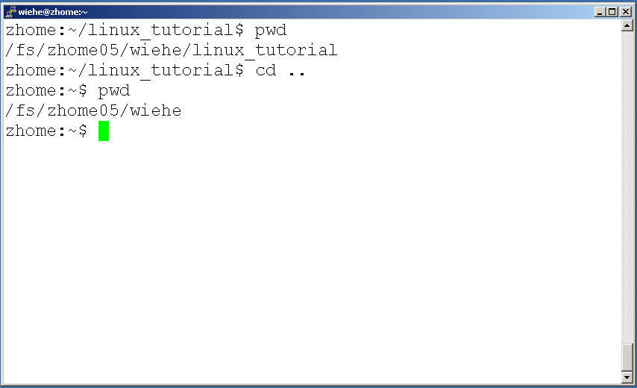
Command: cd
“..” is the location of the directory below current one

Slide 14
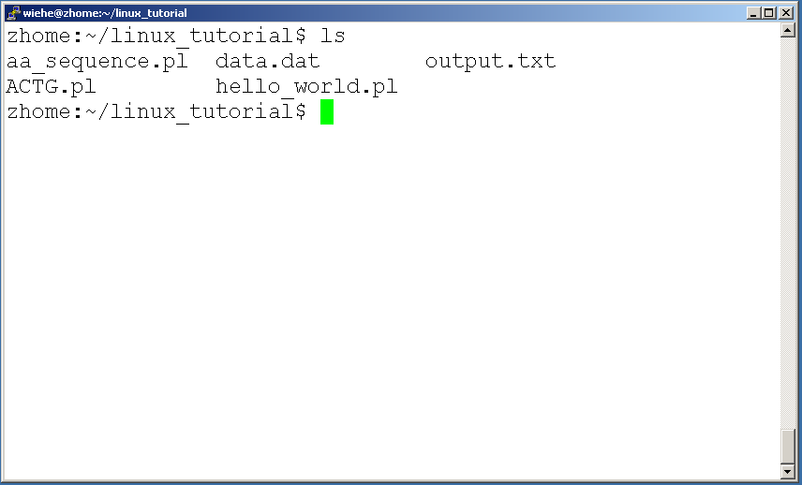
Command: ls
To list the files in the current directory use “ls”

Slide 15
Command: ls
ls has many options
  -l long list (displays lots of info)
  -t sort by modification time
  -S sort by size
  -h list file sizes in human readable format
  -r reverse the order
“man ls” for more options
Options can be combined: “ls -ltr”

Slide 16
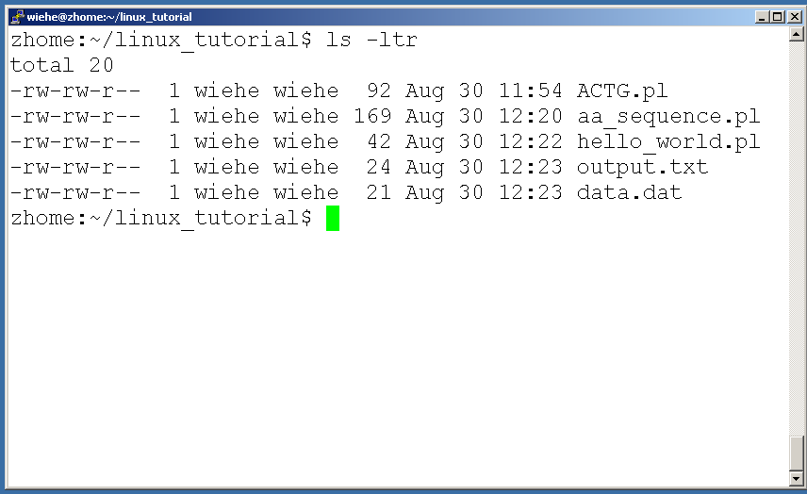
Command: ls -ltr
List files by time in reverse order with long listing

Slide 17
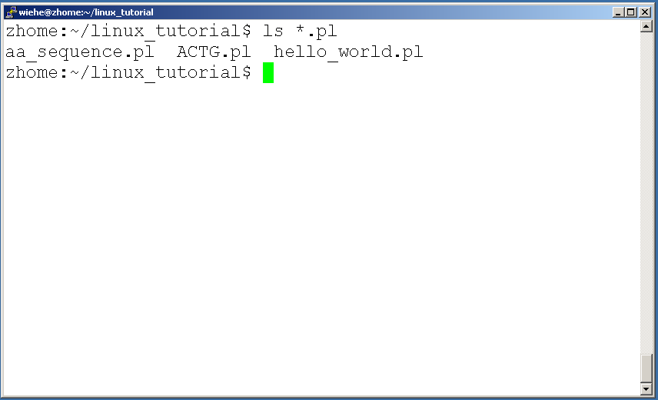
General Syntax: *
“*” can be used as a wildcard in unix/linux

Slide 18
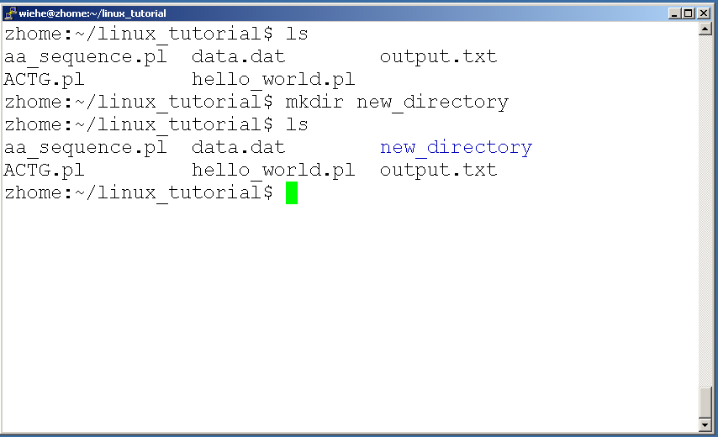
Command: mkdir
To create a new directory use “mkdir”

Slide 19
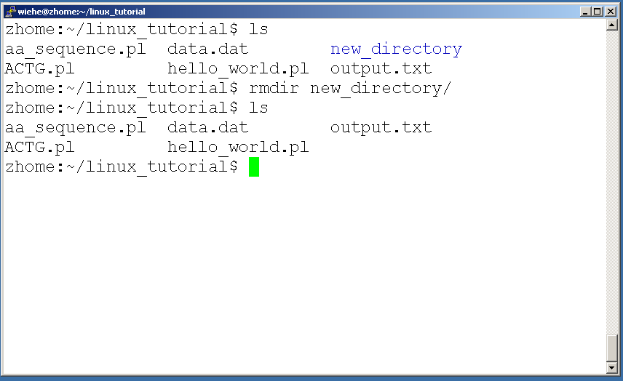
Command: rmdir
To remove and empty directory use “rmdir”

Slide 20
Displaying a file
Various ways to display a file in Unix
  cat
  less
  head
  tail

Slide 21
Command: cat
Dumps an entire file to standard output
Good for displaying short, simple files

Slide 22
Command: less
“less” displays a file, allowing forward/backward movement within it
  return scrolls forward one line, space one page
  y scrolls back one line, b one page
use “/” to search for a string
Press q to quit

Slide 23
Command: head
“head” displays the top part of a file
By default it shows the first 10 lines
-n option allows you to change that
“head -n50 file.txt” displays the first 50 lines of file.txt

Slide 24
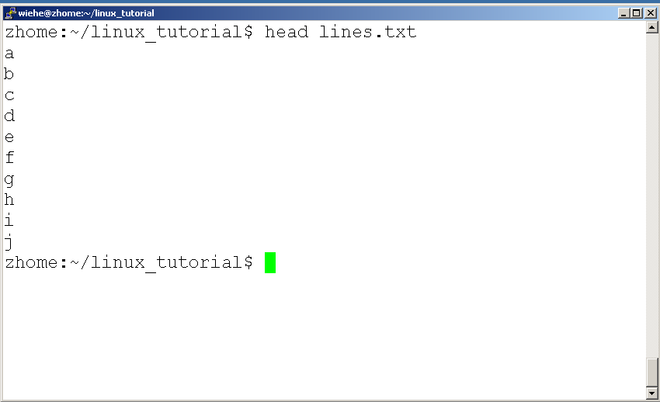
Command: head
Here’s an example of using “head”:

Slide 25
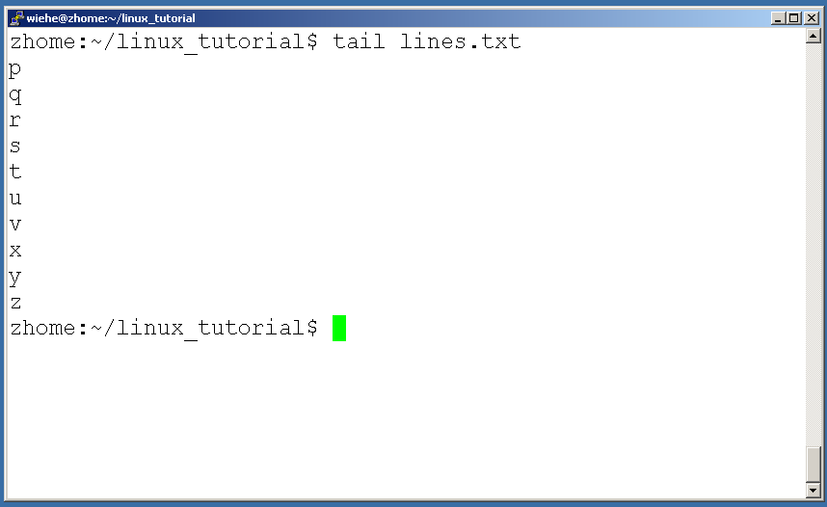
Command: tail
Same as head, but shows the last lines

Slide 26
File Commands
Copying a file: cp
Move or rename a file: mv
Remove a file: rm

Slide 27
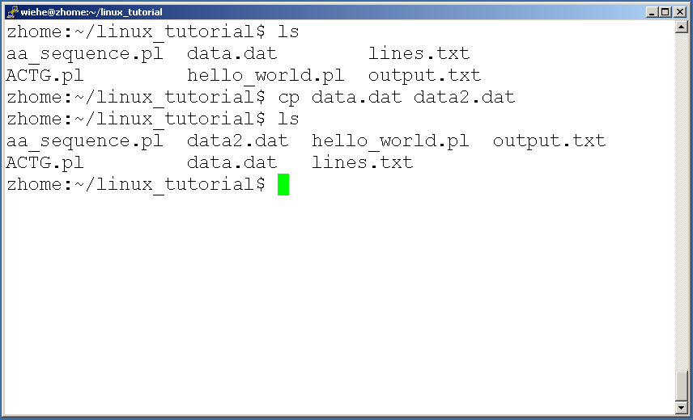
Command: cp
To copy a file use “cp”

Slide 28
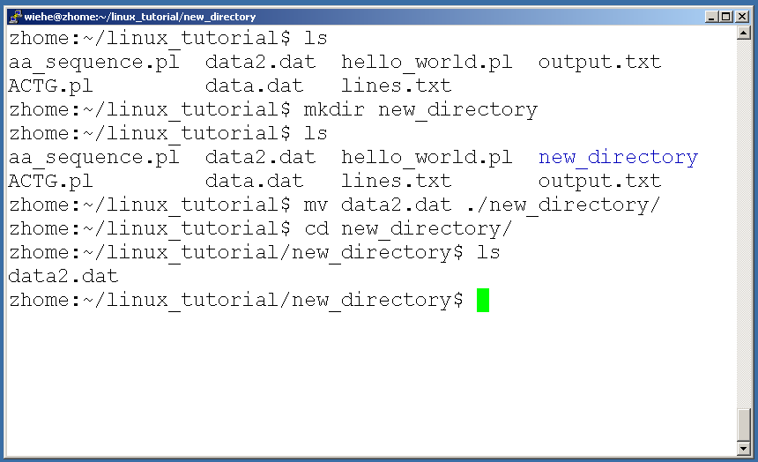
Command: mv
To move a file to a different location use “mv”

Slide 29
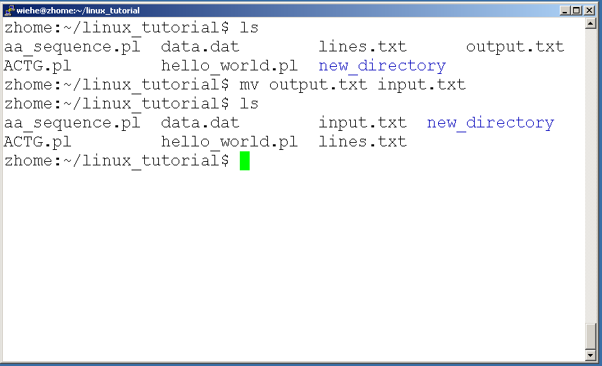
Command: mv
mv can also be used to rename a file

Slide 30
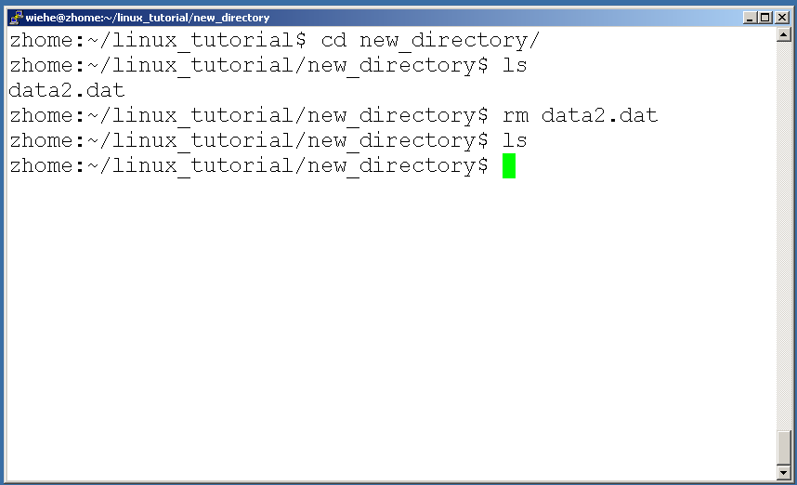
Command: rm
To remove a file use “rm”

Slide 31
Command: rm
To remove a file “recursively”: rm –r
Used to remove all files and directories
Be very careful, deletions are permanent in Unix/Linux

Slide 32
File permissions
Each file in Unix/Linux has an associated permission level
This allows the user to prevent others from reading/writing/executing their files or directories
Use “ls -l filename” to find the permission level of that file

Slide 33
Permission levels
“r” means “read only” permission
“w” means “write” permission
“x” means “execute” permission
  In case of directory, “x” grants permission to list directory contents

Slide 34
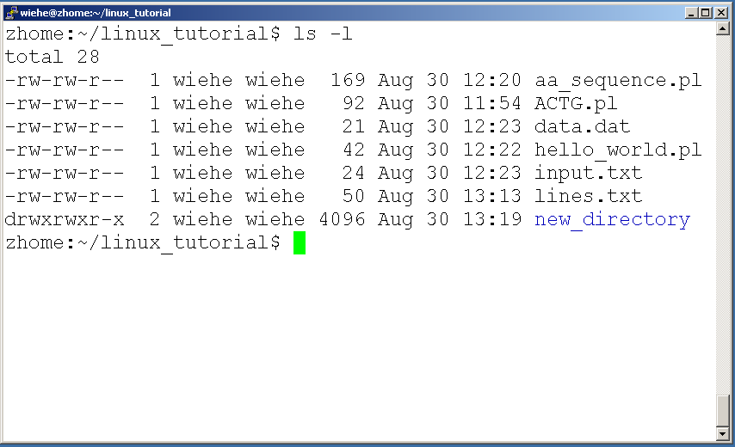
File Permissions
User (you)

Slide 35
File Permissions
Group

Slide 36
File Permissions
“The World”

Slide 37
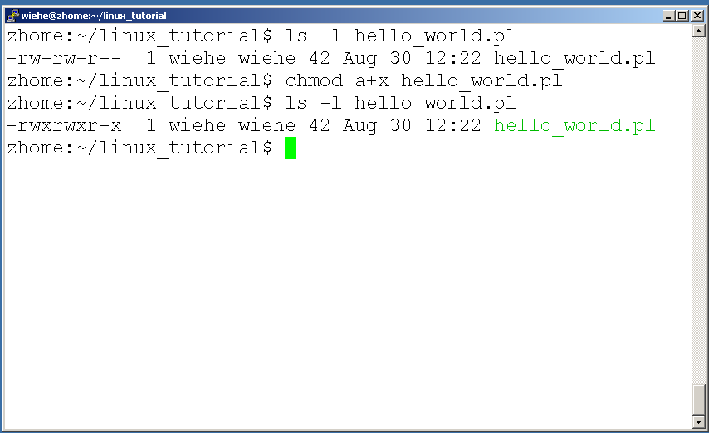
Command: chmod
If you own the file, you can change it’s permissions with “chmod”
  Syntax: chmod [user/group/others/all]+[permission] [file(s)]
  Below we grant execute permission to all:

Slide 38
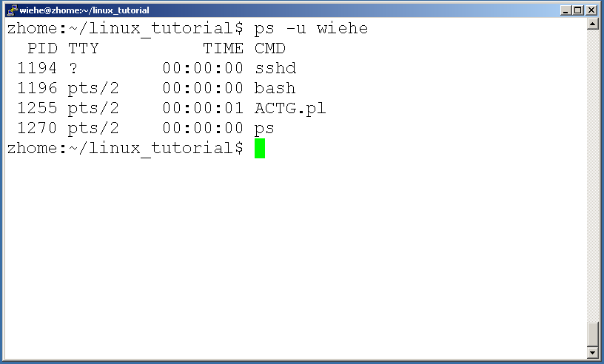
Command: ps
To view the processes that you’re running:

Slide 39
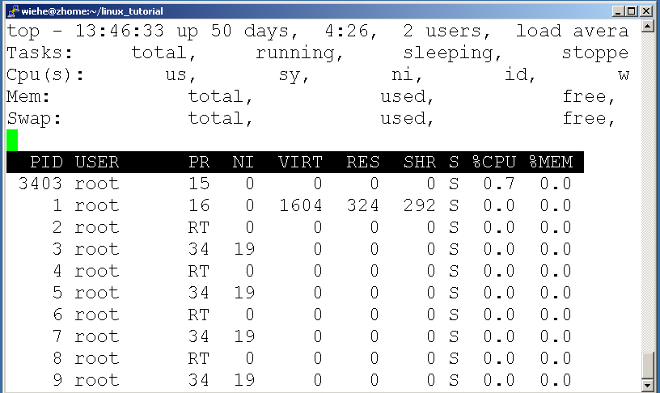
Command: top
To view the CPU usage of all processes:

Slide 40
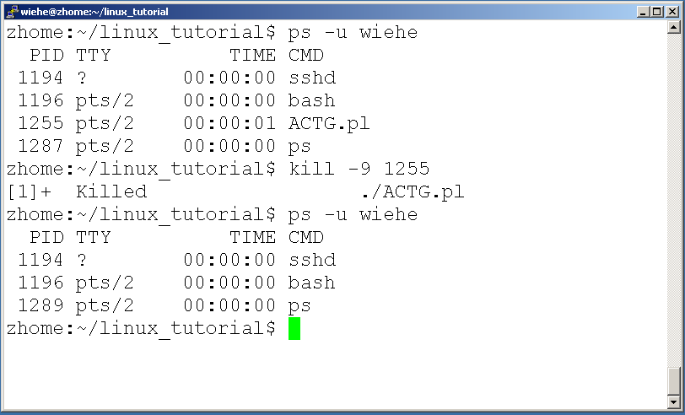
Command: kill
To terminate a process use “kill”

Slide 41
Input/Output Redirection (“piping”)
Programs can output to other programs
Called “piping”
“program_a | program_b”
  program_a’s output becomes program_b’s input
“program_a > file.txt”
  program_a’s output is written to a file called “file.txt”
“program_a < input.txt”
  program_a gets its input from a file called “input.txt”

Slide 42
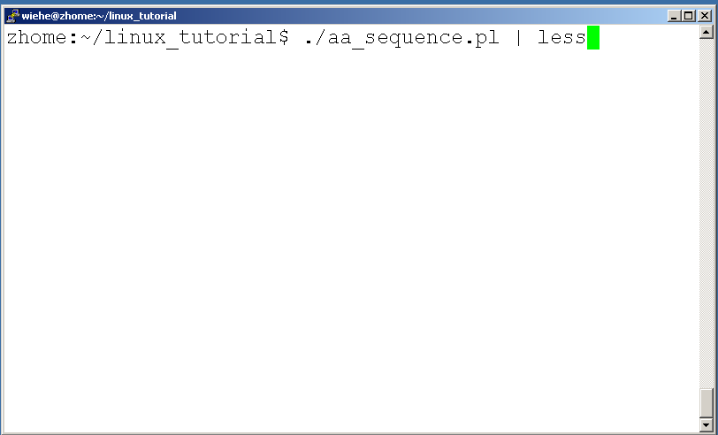
A few examples of piping

Slide 43
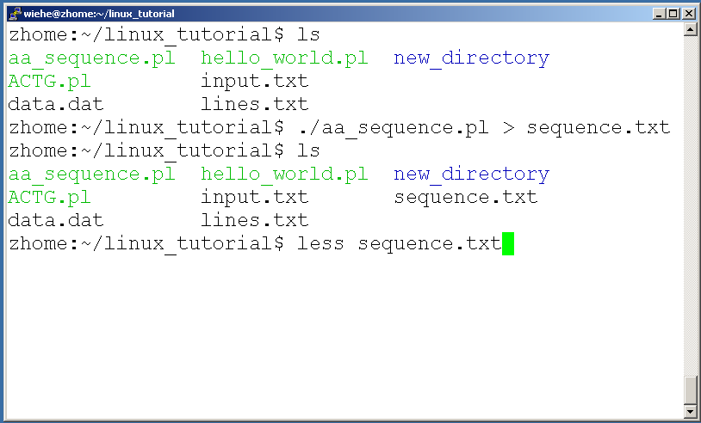
A few examples of piping

Slide 44
Command: wc
To count the characters, words, and lines in a file use “wc”
The first column in the output is lines, the second is words, and the last is characters

Slide 45
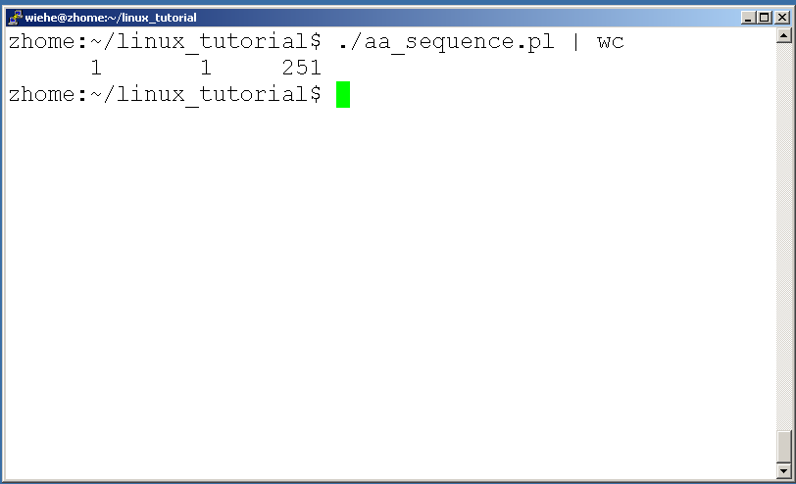
A few examples of piping

Slide 46
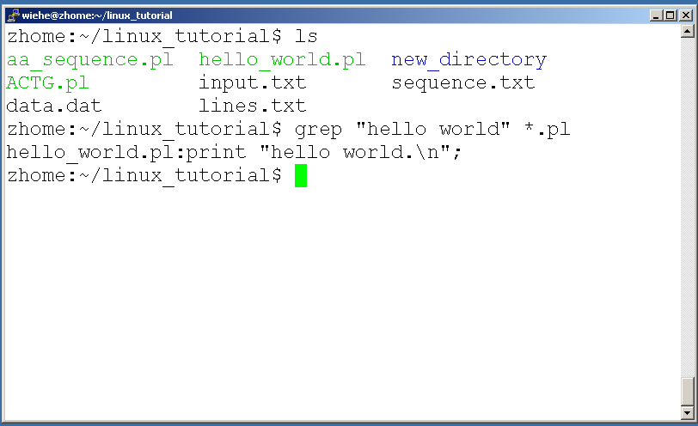
Command: grep
To search files in a directory for a specific string use “grep”

Slide 47
Command: diff
To compare to files for differences use “diff”
  Try: diff /dev/null hello.txt
  /dev/null is a special address -- it is always empty, and anything moved there is deleted

